Slide 1
Workshops & Retreats
Materials for Facilitating Instruction, Reflection, and Community Development
Introduction to Critical Thinking
Meg Gorzycki, Ed.D.

Slide 2
Purpose of Session
Introduce the concept and elements of critical thinking
Identify the objectives of critical thinking and the beneficial consequences of critical thinking
Identify the challenges to critical thinking and explore how these challenges might be overcome
Describe how critical thinking can be applied in our personal, professional, and civic lives

Slide 3

Why Think Critically?
Just raise the price and say its is because of the cost of transportation, and don’t tell them how much executives make
Don’t’ worry about the report; we pay scientists good money to say what we want them say
We can’t tell voters the truth about where their taxes are going
If you tell the public the same lies over and over, they will believe it even if it is not true

Slide 4
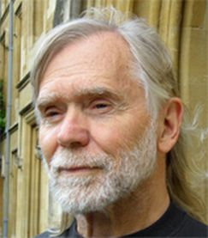
Defining Critical Thinking: Richard Paul
Critical thinking is the art and discipline of analyzing and evaluating the quality of our own thinking, reasoning, and assessing
“Critical thinking is the intellectually disciplined process of actively and skillfully conceptualizing, applying, analyzing, synthesizing, and/or evaluating information gathered from, or generated by, observation, experience, reflection, reasoning, or communication, as a guide to belief and action.”

Slide 5
Intellectual Traits of Critical Thinking: Richard Paul
Trait | Characteristics
Intellectual integrity | Honesty, transparency, respect for other’s work, objectivity
Intellectual humility | Aware of one’s intellectual limits, void of vanity
Fair mindedness | Considers all perspectives, mindful of one’s biases
Intellectual perseverance | Steadfast in inquiry despite obstacles
Confidence in reason | Values logic, avoids judgment based on assumptions
Intellectual empathy | Strives to see motives and rationale for competing ideas
Intellectual courage | Open-minded, values dissent where facts warrant it
Intellectual autonomy | Owns one’s own mind, values independence of conscience

Slide 6

Where Do We Encounter the Need to Think Critically?
Advertising
Government Reports
Political Speeches
Social Media
Religious Sermons
Historical Narratives
Entertainment Media

Slide 7
What Are the Essential Objectives to
Critical Thinking?
To achieve s accurate an account of the truth as possible
To avoid being manipulated, exploited, and cheated
To be as well-informed as possible when we make moral decisions

Slide 8
Elements of Critical Thinking: What Should We Ask?
What is the purpose of the assertion?
What is the key question addressed by these assertions?
What are competing perspectives?
What evidence is offered for assertions?
What are the inferences assertions?
What are the implications of assertions?
What are the key concepts involved in the assertions?
What are the assumptions about assertions?

Slide 9


Examples of Applying the Elements
Why does he say so much about fraud in grassroots organizations and so little about fraud in corporate conduct?
Is he conflating the concept of justice with the concept of social order? Who benefits from that?
Whose point of view is he ignoring?
What is he implying about the distribution of the tax burden?
He did not mention the university’s recent data concerning poverty.

Slide 10

Standards of Critical Thinking: What Should We Ask?
Are these asserts clear enough to understand?
Are these assertions accurate?
Are these assertions relevant?
Are these assertions logical?
Do these assertions address the true scope of the issue?
How precise are these assertions?
What is the significance of these assertions?
How completely do these assertions represent the matter?
Are these assertions fair?
Do these assertions represent the depth of the issue?

Slide 11


Examples of Applying Standards
The scope of her potential solutions seems rather narrow
Where can I look for information that would verify these claims?
Given the context of this community, was that conclusion logical?
What did that comment have to do with this issue?
Was it fair for her to mention the study and not remind us that experts challenged the data?

Slide 12
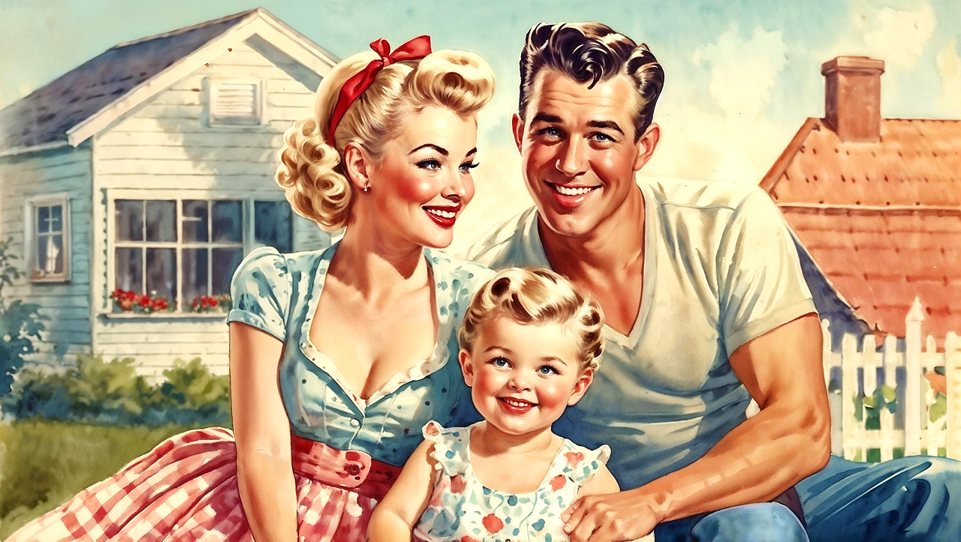
Challenges to Critical Thinking: Denial
Denial is holding onto beliefs long after credible evidence has been offered to discredit the beliefs
Denial is a way deflecting the embarrassment of learning that one has been manipulated, used or lied to
Denial often lacks the imagination it take to see that some people have incentives to lie to and manipulate others
My family is pretty darn smart, and we know that our own government would never let Americans be exploited and lied to by anyone.

Slide 13
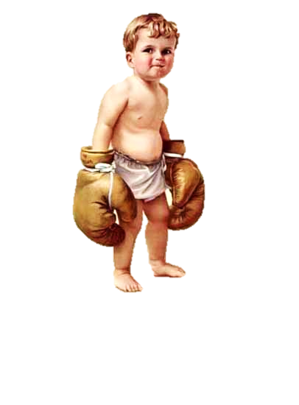
Challenges to Critical Thinking: It is Difficult and Inconvenient
Critical thinking might cause a delay in making an important decision
Critical thinking means thinking about things that I was never taught to think about
Critical thinking might expose the limitations of my understanding of the world, and I do not want others to see that
Why do I gotta be so analytical? It just gets in my way!

Slide 14
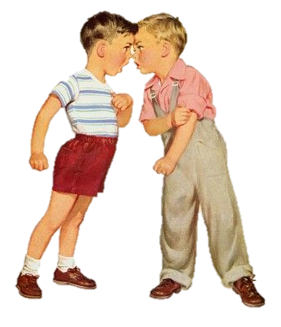
Challenges to Critical Thinking: The Judgement of My Peers
Membership in our social group, our ethnic groups, our political parties, our gender groups sometimes means we experience pressure to think as the group thinks
Having high standards for communication and representation of the facts can sometimes alienate friends and family
You can’t say I ain’t got no proof! Whadd’ya- some kind of radical?

Slide 15
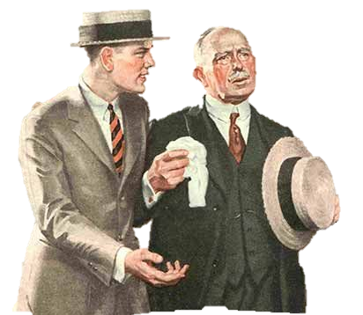
Challenges to Critical Thinking: Those Who Control the Narrative
Americans have always been divided on how much influence the common citizen should have in governance and self-representation
James Madison, Alexander Hamilton, and other authors of the US Constitution found it desirable to limit democracy by limiting who could vote, who was free, and who could elect senators
In modern times, limiting the voice of the people is achieved by Gerrymandering districts and private donations to campaigns
No son, it is not wise to educate the common masses and give everyone the right to vote…They become harder to control that way!

Slide 16
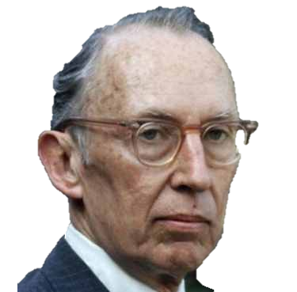
Challenges to Critical Thinking: Those Who Control the Narrative
1971, tobacco attorney Lewis Powell (later appointed to the Supreme court), issued the “Powell Memorandum,” a vitriolic reaction to “excessive” democratization during the 1960s
It warned that liberalism was determined to destroy capitalism, and that criticism was coming from intellectuals, university professors, civil rights activists, journalists, anti-war movements, and religious leaders
It called for greater suppression of liberalism through an increase in the role of lobbying by businesses and wealthy corporations

Slide 17
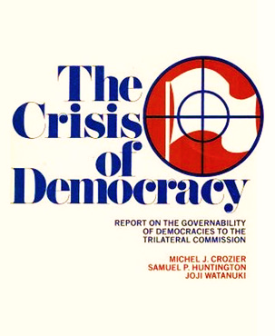
Challenges to Critical Thinking: Those Who Control the Narrative
In 1975, the Trilateral Commission, a coalition of social scientists from the U.S. U.K, and Japan, (funded by David Rockefeller) published The Crisis of Democracy.
It warned that democratic movements of the 1960s wanted to reduce the authority of government while expanding its role in providing for the public welfare. It asserted these reforms would result in the loss of America’s dominance in world affairs and the global economy.
It called for a concentration of power in the state
It recognized that in a democracy, the people will only give the state absolute power if they are convinced that their well-being is threatened by ominous forces

Slide 18
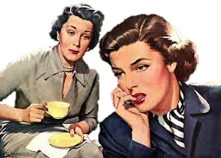
Challenges to Critical Thinking: Fear and Doubt
Be careful. If you ask too many questions, they are going to think you are a whistle-blower and they will fire you.
Fear about the consequences of our critical thinking decreases the ways we may be able to improve our lives
Doubts about our ability to see things for what they are allows people who do not have our best interests in mind to make decisions for us.
Doubt feeds the idea that nothing we think about right and wrong matters because we don’t matter

Slide 19
Summary of Ideas about Critical Thinking
Critical thinking is a way of assessing the value of ideas and assertions
Critical thinking enhances our moral decision-making
Critical thinking is instrumental in protecting ourselves and society from predatory and manipulative people and institutions
Critical thinking requires self-discipline, objectivity, intellectual curiosity, empathy, courage, confidence in reason, and respect for our own conscience
Critical thinking can be improved with practice, learning more about the subject, participating in discussions about matters with others who are committed to critical thinking, and evaluating the credibility of sources of information

Slide 20
Questions for Personal Reflection & Discussion
How would you describe your ability to think critically? What do you regard as your areas of strength and limitations?
Do you apply equal critical thought to controversies in your community? Explain your approach to this.
How well do you understand the causes of society’s success and failures, and how does that impact your perception of the world?
Do you believe that people have a moral obligation to think critically? Explain why.
What is your greatest obstacle to critical thinking and how could it be overcome?

Slide 21
References
Atkins, Larry. Skewed: A Critical Thinker’s Guide to Media Bias. NY: Prometheus, 2016.
Gorzycki, Meg, Linda Elder, and Richard Paul. Historical Thinking: Bringing Critical Thinking Explicitly into the Heart of Historical Study. Tomales, CA: Foundation for Critical Thinking, 2013.
Paul, R. W. (2005, Summer). The State of Critical Thinking Today. New Directions for Community Colleges, 27-38.
Paul, R. and Scriven, M. “Critical Thinking as Defined by the National Council for Excellence in Critical Thinking, 1987.” Foundation for Critical Thinking. Defining Critical Thinking
Powell, Lewis. Confidential Memorandum. Attack on American Free Enterprise System.1971. Reuters, The Memo.
The Trilateral Commission. The Crisis of Democracy. 1975. https://ia801308.us.archive.org/23/items/TheCrisisOfDemocracy-TrilateralCommission-1975/crisis_of_democracy_text.pdf

