Slide 1
Workshops & Retreats
Materials for Facilitating Instruction, Reflection, and Community Development
Our Conscience
Meg Gorzycki, Ed.D.

Slide 2
Purpose of This Session
Understand the concept of conscience and how it relates to spirituality, secular ideals and social science
Understand how the Catholic Church influenced the exercise of individual conscience and how its concept of conscience evolved
Describe the Judeo-Christian infusion of conscience in modern history and its contemporary teachings on leavening one’s conscience into our economic and political lives
Identify threats to our conscience
Explore the ways individuals can cultivate their own conscience

Slide 3
Defining Conscience
In Judeo-Christian tradition, conscience is an inborn capacity to sense right and wrong and to intuit the will of God where all moral decisions are concerned.
Conscience presumes free will and may be informed by reason and knowledge, but is greater than reason and knowledge since it is thought to be the voice of God
From a secular perspective, the conscience represents a store of moral wisdom and the individual’s awareness of and ability to perceive the moral consequences of actions and ideas.

Slide 4
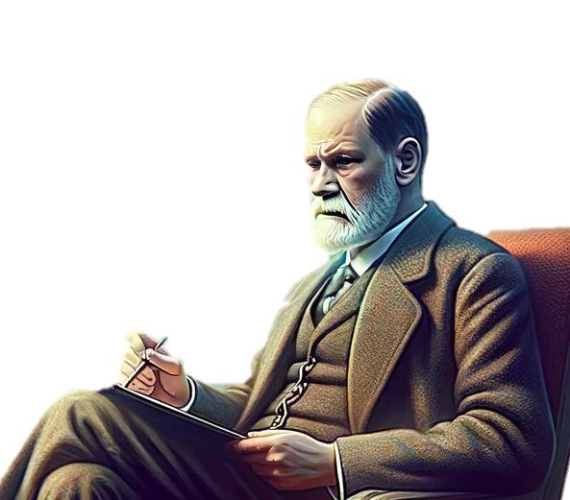

Defining Conscience: Psychologist Sigmund Freud
Freud held that the “super-ego” is the part of our personality that modifies assimilates socially acceptable norms and moral guidelines so we can obtain what we want and without punishment
Freud saw religion largely as a source of shame, repression and guilt
Ethical behavior was not as motivated by ideals as it was by the desire to remain in good standing with others as individuals perused their desires
You are not sharing with others because you want to love as God loves, but because you want others to like you and share their stuff with you.

Slide 5
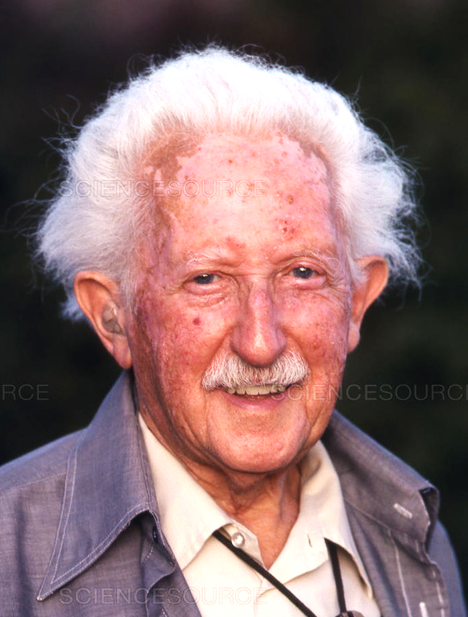
Defining Conscience: Psychologist Erik Erikson
Erikson held that God and religious experiences played a major role in shaping one’s sense of identity and ethical ideals
In youth, children learn morality which, like Freud’s idea of super-ego, is highly responsive to social norms and rules
In adulthood, individuals form ethical ideals and, in maturity, temper the influence of external authorities in favor of conscience

Slide 6
Defining Conscience: Classical Perspectives
Before there was Christianity, people believed that a source greater than themselves existed and seeded hearts and minds with desire for knowledge and truth
Ancient Greeks believed people had immortal souls and that knowledge of ideas is innate or inborn
The Greek term, conscientia, refers to “shared knowledge” or knowledge that is shared with one’s deepest sense of self, which is also known as synderesis.
Conscience was concerned with moral judgement

Slide 7
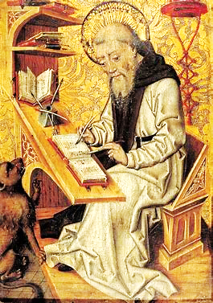
Conscience and St. Jerome
St. Jerome (4th century) used the word “conscience” to include the Greek concept of “synderesis”
The early Church taught that God endowed individuals with a sense of morality that represents God’s will
St. Jerome’s concept of synderesis is a cornerstone of modern Catholic teachings on conscience

Slide 8
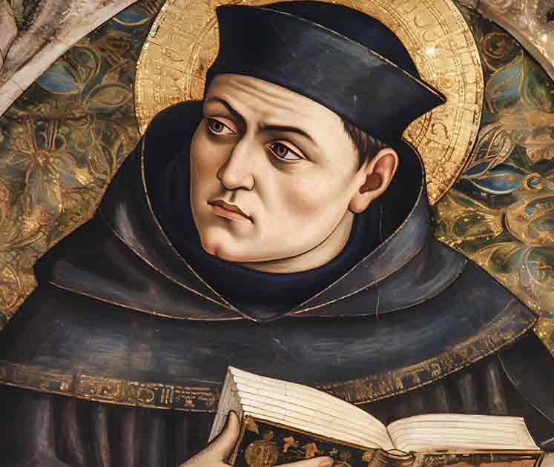
Conscience, Synderesis, and Thomas Aquinas
Synderesis is the innate awareness of God’s laws and is cannot be in error
Conscience directs how individuals apply the directives of God’s law
Conscience can be in error because people may not have sufficient knowledge to judge very well
It is right to disobey laws that violate the common good and are not extracted from religious doctrine

Slide 9
Conscience and Dissent
For centuries, obedience to God meant obedience to the Catholic Church, even when the Church waged wars, persecuted non-Christians, and accumulated great wealth while many lived in poverty
Following one’s conscience was often dangerous as it could lead to excommunication or execution
The Reformation challenged the authority of the Catholic Church and the morality of some of its practices
The Enlightenment challenged the idea that religious doctrines were necessary to the formation of an ethical conscience, as human beings had the power of reasoning

Slide 10
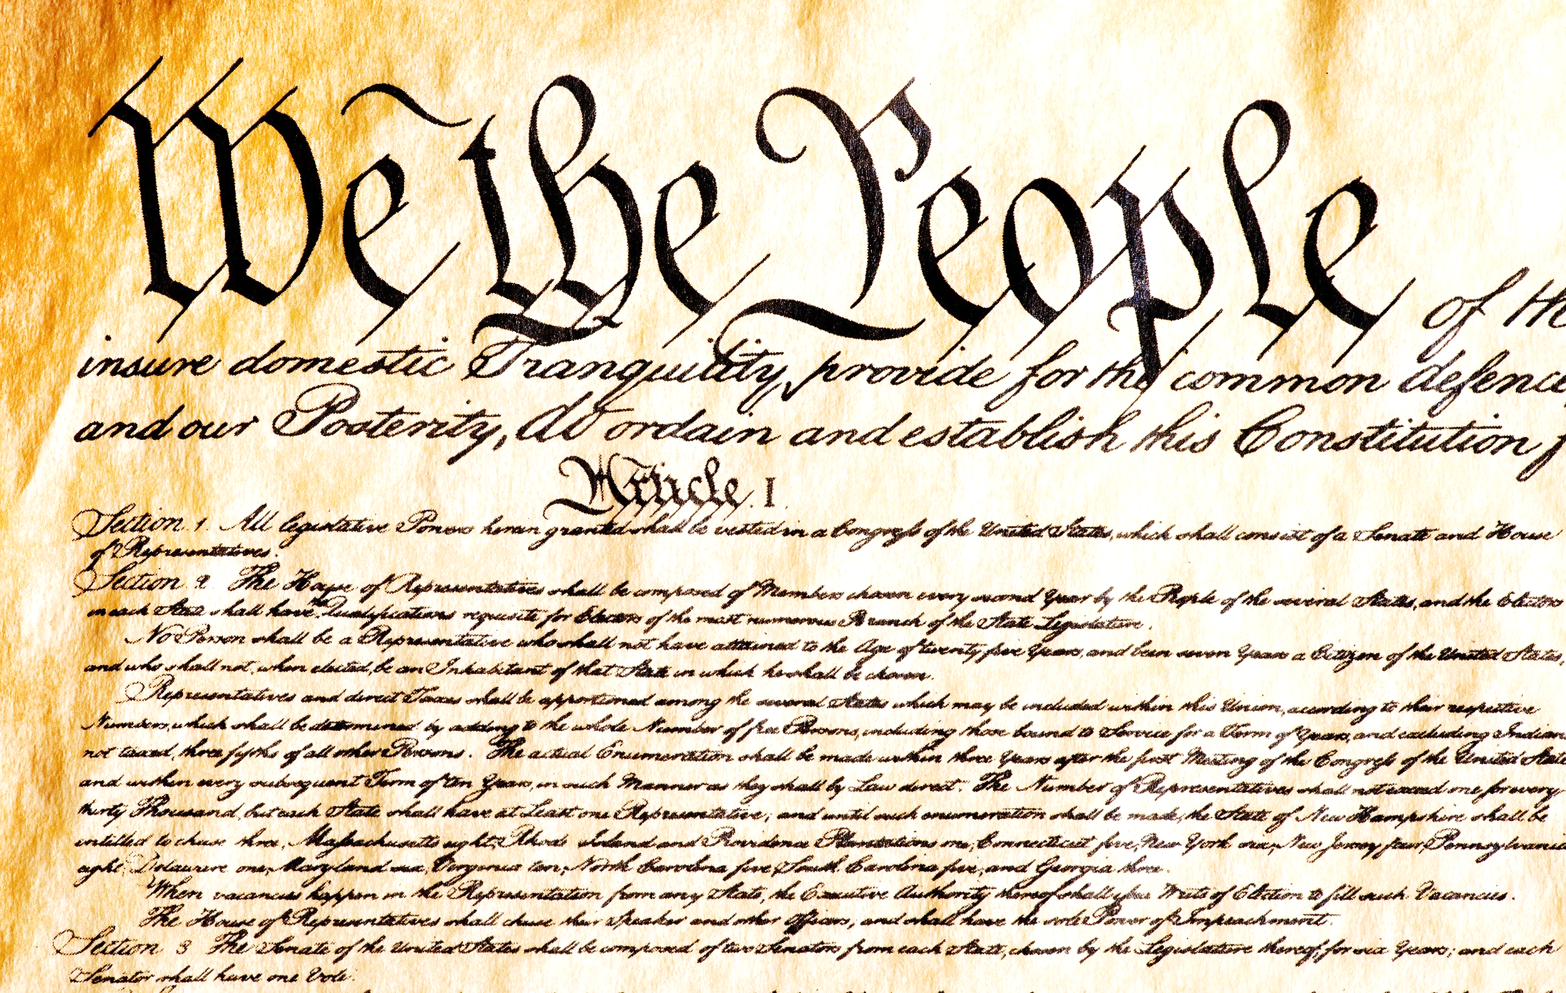
Conscience and Revolution
Until late 1700s, Catholicism was the state religion in Western nations
Democratic reforms, nationalism, and revolutions erupted in Europe and America in the 18th and 19th centuries
The Catholic Church lost much of its secular power during the 1800s and society increasingly appealed to science and reason for moral guidance

Slide 11
Conscience and Modern State in Conflict
Catholic Tradition
State must give preferential treatment to Church teachings in state affairs and laws
Democratic Tradition
State must respect pluralism and religious freedom and not surrender autonomy to Church

Slide 12
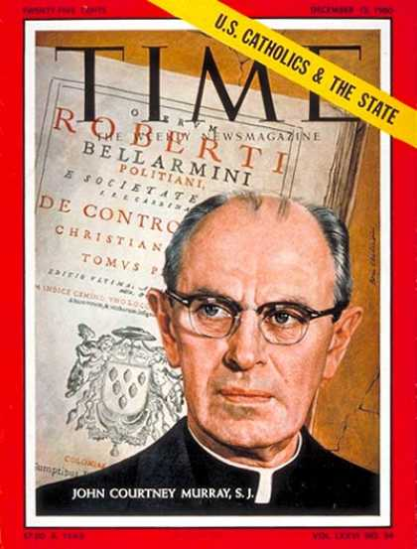
John Courtney Murray’s Revolution
John Courtney Murray, Jesuit, led Vatican II’s reforms on Church and State in the 1960s
The Vatican announced respect for religious liberty
The Church began an era dialogue with people of all faiths around the world
The Church affirmed the dignity of personal conscience and dissent

Slide 13
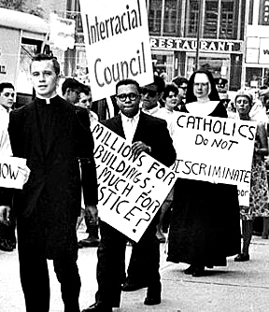
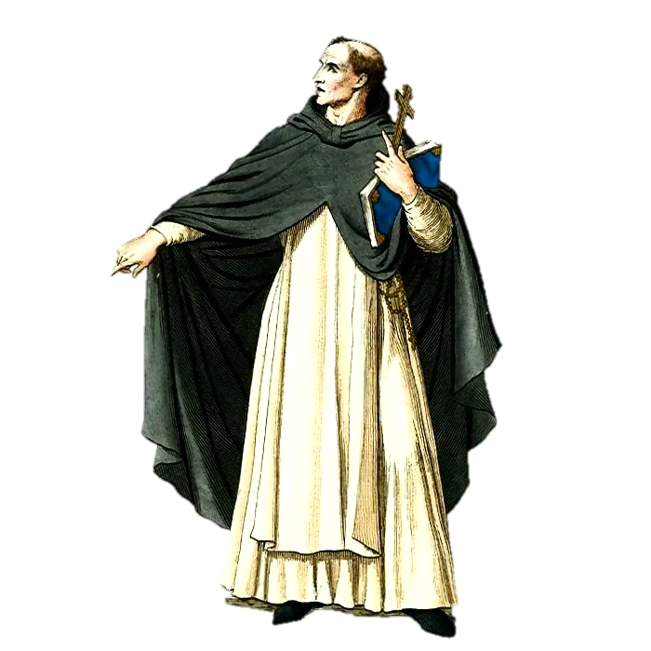
John Courtney’s Revolution in America
Traditional Catholicism
Murray’s Catholicism
We must have dialogue and respect for all faiths, freedom of conscience, and use democratic institutions to bring the love of God to the world
Pluralism, and religious freedom will corrupt the conscience and destroy faith… Democracy is dangerous to the one true faith!

Slide 14
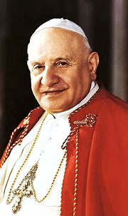
Modern Catholic Teaching on Conscience
Pacem in Terris, 1963
John XXIII
Pope 1958-1963
The world's Creator has stamped man's inmost being with an order revealed to man by his conscience; and his conscience insists on his preserving it.
The laws of God commands piety, justice, love of neighbor and respect for human dignity

Slide 15
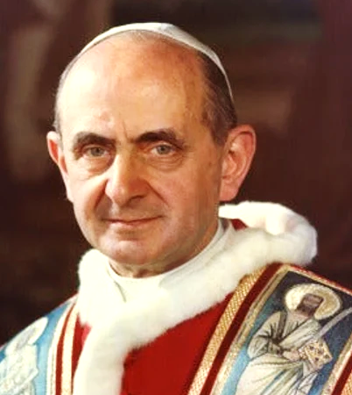
Modern Catholic Teaching on Conscience
Dignitatis Humanae, 1965
Paul VI
Pope 1963-1978
The human person has a right to religious freedom.
All men are to be immune from coercion on the part of individuals or of social groups and of any human power, in such wise that no one is to be forced to act in a manner contrary to his own beliefs…
The right to religious freedom has its foundation in the very dignity of the human person as this dignity is known through the revealed word of God and by reason itself.
The right to religious freedom is a civil right

Slide 16
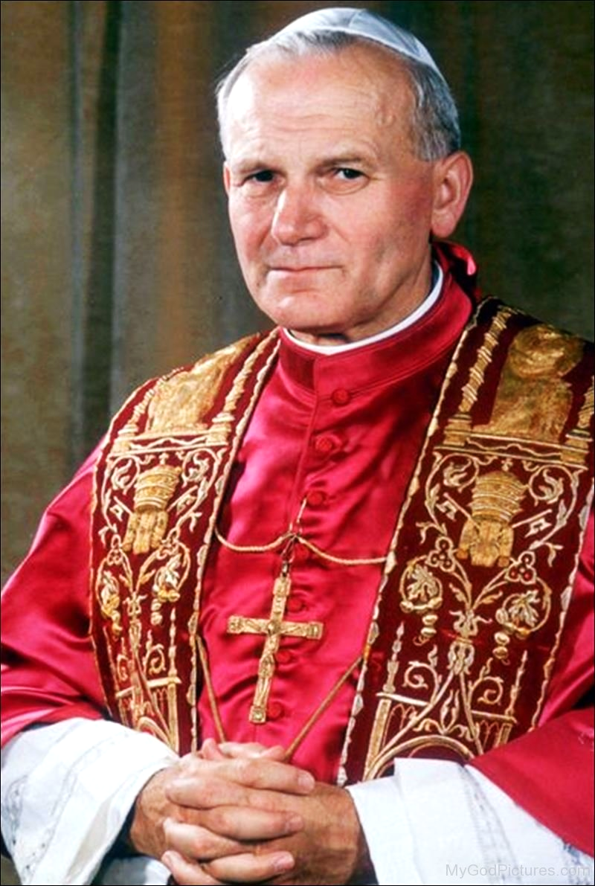
Modern Catholic Teaching on Conscience
Veritatis Splendor, 1993
John Paul II
Pope 1978-2005
Conscience may be a complex matter but does not mean morality is relative.
Conscience is "the sanctuary of man, where he is alone with God whose voice echoes within him…” It is the dialogue “of God and man.”
The ultimate truth that mankind is created in God’s image and for a sacred purpose must direct political activity, for without these values, democracy becomes an agent of totalitarianism.

Slide 17
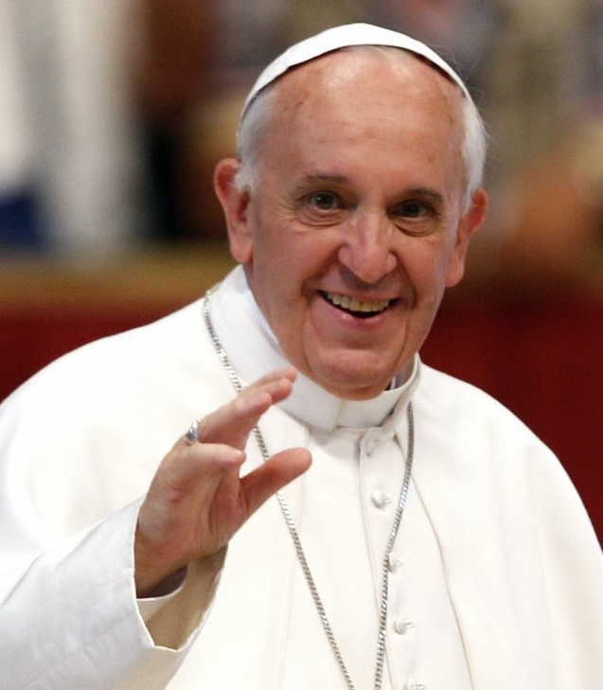
Modern Catholic Teachings on Conscience
Amorous Laetitia, 2016
Francis
Pope 2013-2025
We must “make room for the consciences of the faithful, who very often respond as best they can to the Gospel amid their limitations…”
“We have been called to form consciences, not to replace them.”
Our conscience is vulnerable to attractive and powerful ideas that are oppositional to our good and the good of others
Education must illuminate how ethical habits of mind and action are beneficial to the one who has these habits

Slide 18
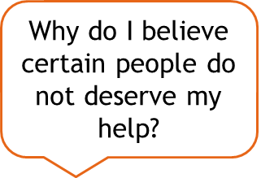

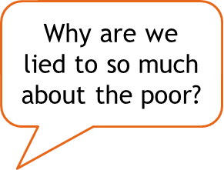

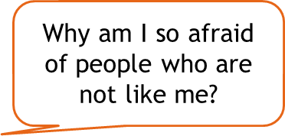

Challenges to the Integrity of Our Conscience: Telling the Truth
Without honesty about our conditions, our conscience is vulnerable to lies about how and why people are suffering
Without examining our role in the perpetuation of injustice, we limit what God has to say to our conscience

Slide 19

Challenges to the Integrity of Our Conscience: Hopelessness
Hopelessness decreases our faith that God is always with us
Hopelessness tells us that it does not matter if we exercise our conscience
Hopelessness can be overcome in many ways
I like to watch documentaries about resilient people and extraordinary leaders
Sometimes I go to Mass and meditate on the gift of the sacraments
When I feel hopeless, I visit people who encourage and inspire me

Slide 20
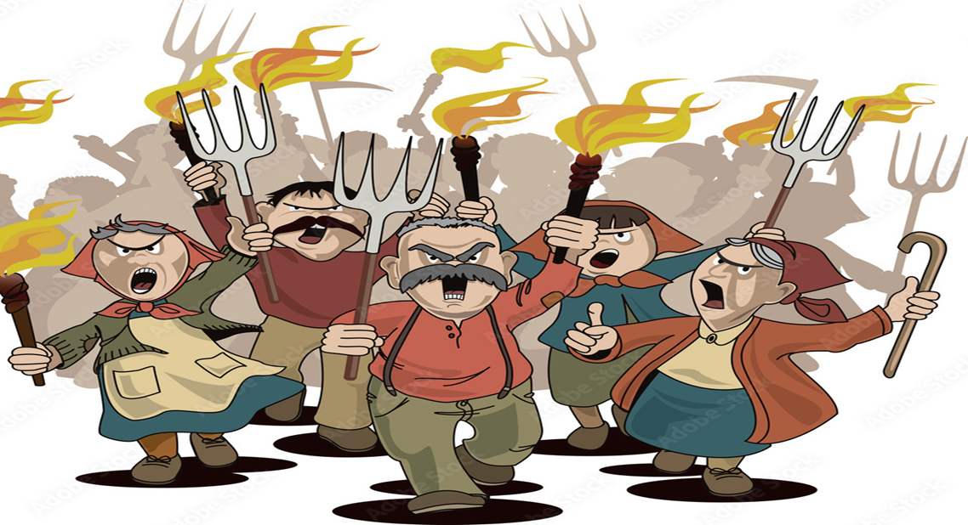
Challenges to the Integrity of Our Conscience: Toxic Culture
Pornography and violent video games are free speech!
Those people do not deserve handouts!
Build a wall!
God hates homosexuals!

Slide 21
How Can We Cultivate Conscience?
Prayer, personal reflection, inventories and evaluations of one’s thoughts and actions
Study sacred teachings and examples and consider how they apply to our lives and our development
Learn about the world, listen to its people, and empathize with the vulnerable and despised
Explore how good role models bring ethics to bear on institutional behavior
Hold ourselves to high standards of empathy, mercy, humility, and charity
Maintain a critical attitude towards popular culture, social and mainstream media, and be highly selective about what attitudes, values and beliefs we assimilate
Be selective about the company we keep and nurture friendships with those who share our commitment to spiritual and ethical development

Slide 22
Summary of Main Idea about Conscience
Synderesis is an internal sense of goodness, store of practical and moral knowledge that is universal and accessible through refection and inquiry
Judeo-Christian tradition holds that Conscience is the voice of God that holds our reasoning accountable to God’s will, which is to love others and wisely steward all creation
The Judeo-Christian tradition acknowledges that society’s standards of goodness and ethical conduct frequently differ from and compete against those of God
In democratic and religious traditions, everyone has a right to exercise one’s conscience and to dissent from the laws and social norms when they assault the dignity of humanity and injure people by way of physical force or institutional policy

Slide 23

Discussion Questions
How would you describe your efforts to cultivate your own conscience, and what determines your efforts?
What is the difference between the values and priorities of our society and the values and priorities of Judeo-Christian teachings, and how do you determine which should dominate your conscience?
What are the consequences of allowing popular culture to control our internal narratives about right and wrong?
What are some strategies we can use to improve our exercise of conscience?

Slide 24
References
Catechism of the Catholic Church, sec. 1776, Catechism of the Catholic Church
Conn, Walter E. “Erik Erikson: The Ethical Orientation, Conscience and the Golden Rule.” Journal of Religious Ethics, 5(2): 249-66. Fall 1977.
Hogan, Linda. Confronting the Truth: Conscience in the Catholic Tradition. NY: Paulist Press, 2000. Pp. 26–27.
Medieval Theories of Conscience. Stanford Encyclopedia of Philosophy. Medieval Theories of Conscience (Stanford Encyclopedia of Philosophy)
Pierce, C.A., 1955, Conscience in the New Testament: A Study of Syneidesis in the New Testament , In the Light of its Sources and with Particular Reference to St. Paul, With Some Observations Regarding its Pastoral Relevance Today (Studies in Biblical Theology no. 15), London: SCM Press.
Saint Thomas Aquinas. Summa Theologica,1358 (Fathers of the English Dominican Province trans., Benziger Bros. https://www.basilica.ca/documents/2016/10/St.%20Thomas%20Aquinas Summa%20Theologica.pdf [https://perma.cc/7X5D-8JMP].
Schultz, Samuel HJ. "Civil disobedience: A constitutional alternative to injustice." Mitchell Hamline L. Rev. 45 (2019): 650.
Strohm, Paul, 2011, Conscience: A Very Short Introduction, Oxford University Press.

