Slide 1
Workshops & Retreats
Materials for Facilitating Instruction, Reflection, and Community Development
Historiography in K-12 Education: Developing Civility & Scholarship
Meg Gorzycki, Ed.D.

Slide 2
Purpose
Define history and identify its function in society
Introduce the concept of historiography and the role it plays in creating history narratives and teaching history
Explore the relationship between historiographical awareness and civic life
Demonstrate how historiography can be taught in primary and secondary social studies classes
Discuss the ways people can improve their understanding of the world and critique assertions about our conditions and needs by improving their understanding of historiography

Slide 3
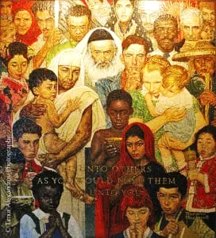
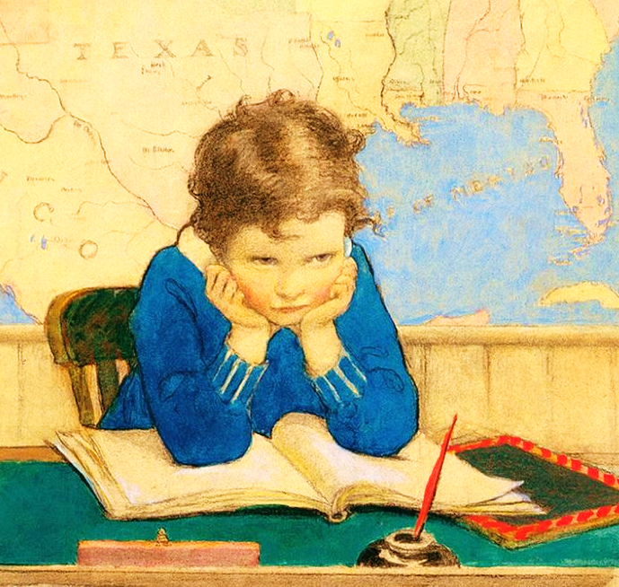
Conflicting Understandings of History
History is just a bunch of dumb old boring stories about people in old fashioned times.
History is a record of human development that helps us understand how we came to be as we are, the nature of the human condition, and the benefits and detriments of culture we create.
Jesse Wilcox Smith, “Back to School Again, 1928
Norman Rockwell, “The Golden Rule,” 1961

Slide 4
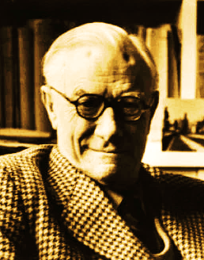
Defining History
History is not an exact science
English Historian Eward H. Carr, said it was impossible to establish all facts, and when facts were presented, they had to be verified by credible witnesses.
He noted that since authors choose some facts and not other facts, their narratives are often biased.

Slide 5
Defining History
Generally, history is a systematic study of the past that creates accounts of human activity based on artifacts, written records, and oral traditions
Historians create a picture of the past by examining economic systems, religion, culture, language, governance and law, and literature
Historians may specialize in particular areas of the past, such as the history of the Ancient Near East (a geographical and cultural focus), or the economic history of the United States (a focus on ne aspect of one people), or African American dissent in the 1960s (an examination of a segment of specific population during a specific era of the past).
History that is not supported by written records is the domain of anthropology and archaeology
Time prior to the development of written records is generally called “pre-history,” which covers everything from Earth formation until the emergence of writing and civilization (settlement and agriculture).

Slide 6
The Value of History
“History is not a burden of memory but an illumination of the soul.” (Hans-Georg Gardemer, German Philosopher)
“History is not history unless it is the truth.” (Abraham Lincoln, US President)
“History is, in its essential, is the science of change. It knows and teaches that it is impossible to find two events that are ever exactly alike, because the conditions from which they spring are never identical.” (Marc Bloch, French Historian)
“The principle office of history I take to be this: to prevent virtuous actions from being forgotten, and that evil works and deeds should fear infamous reputation in posterity.” (Tacitus, Roman Historian)

Slide 7
The Value of History
“The function of the historian is neither to love the past nor to himself from the past , but to master and understand it as the key to understanding the present.” (Edward Carr, English Historian)
“Those who don’t know history are doomed to repeat it.” (Edmund Burke, British Philosopher)
“To be ignorant of the past is to be forever a child.” (Cicero, Roman Politician)
“History is the only laboratory we have to test he consequences of thought.” (Etienne Gilson, French Historian)

Slide 8

What is Historiography?
Did you know that there are many schools of historiography —like Marxist, Orthodox, Revisionist, Critical, Deconstructionist, and Post-Colonial? I just thought history was a bunch of names and dates!
Historiography is the study of how historical narratives are constructed and the methods used to study history
It also analyzes the way history has been interpreted
The methods we use to craft historical narratives influences how people, their culture, character, concerns, causes and their value are represented… for better or worse…

Slide 9
Schools of Historiography and Purpose: Some Examples
Historiographical School | Purpose of History
Orthodox | Generally nationalistic in outlook; history as chronology of nation’s progress, tales of national heroes, and vindication of national ambitions and conduct
Marxist | Frames history as chronology of class conflict and sees historical outcomes as result of economic dynamics
Revisionist | Revises the orthodox view to include experiences of marginalized populations and perspectives of events
Historical Materialism | Focuses on economics, technological development, and social structures as explanations for how society lives
Feminist | History is the product of male-dominated culture; seeks to restore women’s perspective of past as well as their lived experiences
Theodicy | Presents history as unfolding of divine will/God’s plan; history marks progress towards an eschatological end

Slide 10
What is the Purpose & Value of Historiography?
Historiography helps historians write narratives based on proven facts rather than assumptions and false claims
Historiography allows historians to develop specialized methods for studying specific subjects such as religious, social, diplomatic, or military history
Historiography encourages readers to approach history from a critical perspective that considers the credibility of sources, potential biases in reporting, the context in which past events occurred, the motives for people’s actions, and to appreciate competing interpretations of past events and their significance

Slide 11

How Does Historiography Enhance Our Civic Outlook & Attitudes Toward Others?
Historiography led me to rely less on social media to understand the world, to read more and more history and credible journalism
Historiography showed me about how language can hide the truth or reveal the truth
Historiography helped me to see the value of diverse perspectives, and that the context of events matters in how we understand the past.
Historiography helped me detect false claims in speeches

Slide 12
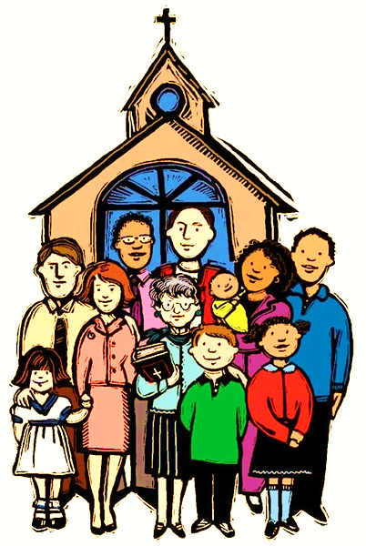
How Does Knowing about Historiography Enhance Our Moral Decision-Making?
Historiography helped me overcome my tendency to be judgmental.
Historiography helped me see that not all leaders tell the truth in speeches and interviews
Historiography helped me see poverty and bigotry from the victim’s point of view
When we learned about historiography in school, we got to see how telling stories can help people or hurt them.

Slide 13
Sources of Historical Narratives
Primary Sources are reports from people who participated in or were eye-witnesses to past events
When speaking about general subjects like conditions in a certain place and time, government documents, public health records and newspaper articles may also be primary sources
Secondary Sources are reports from second-hand reports or commentary about events
Secondary Sources are also the historical narratives authors use to create new narratives about the past or biographies

Slide 14
Steps to Create Historical Narratives
Narrative
Identify Subject and Purpose
Select and verify facts
Determine relevance of facts and details
Identify biases in sources
Determine meaning and significance
Maintain objectivity when creating narratives
Decipher cause & effect
Remind readers of context of events

Slide 15
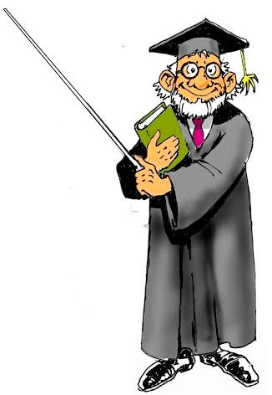
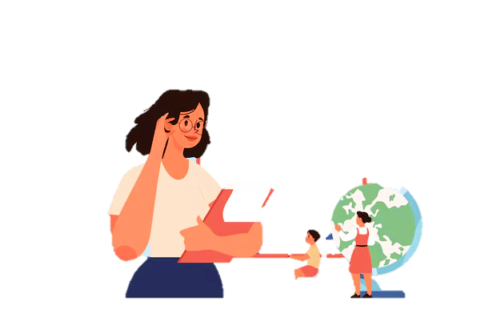
When Should We Teach Historiography?
Professor Oldskool
Professor Leadswell
Historiography is for future historians and advanced students of history; it should not be taught until college or graduate school.
Historiography can be introduced in ways that kids can understand. We do not need to teach children all about epistemology and methodology. We need to help them understand that how we report the past makes a difference in whether we the story is fair and honest.

Slide 16
Principles of Teaching Children about Historiography
Make the lessons relevant by getting students to imagine what it would be like to have somebody tell their story
Engage students and invite students to list the things they would like to have in stories about themselves
Invite them to say who would make the best author of their story and why
Facilitate a discussion about how the authors are going to get information for the story and help them with understanding sources like diaries, letters, family stories, interviews, and various documents like report cards
Facilitate a discussion based on question: “What things would make the story a very good story and why?” Coax them to consider honesty, fairness, and why details matter

Slide 17
Scaffolding Lessons on Historiography
Historiography can be introduced incrementally over grades whereby teachers review the principles and value of historiography and add new information about it helps us understand the stories about the past and to determine whether they are good records of the past or bad records of the past
Lessons can be scaffolded over a unit of history in a single class by incrementally introducing information and providing time for in-class exercises and discussions
Using a taxonomy of historiographical thinking helps instructors develop lessons and target learning outcomes

Slide 18
A Taxonomy of Historiographical Thinking
Creating
Evaluating
Analyzing
Applying
Understanding
Declarative Knowledge/Remembering
Design a plan to study an event of the past and make an outline that includes methods and sources
Determine whether the narrative used methods effectively, and is accurate, fair, and supports assertions with appropriate evidence
Determine pros and cons of using certain methods or sources
Demonstrate ability to pair methods with a historical inquiry to explain something in the past
Describe what historians do and identify the methods they use to study and write history
Recall key facts: People write history and people do not always know facts or tell the truth
Based on Bloom’s Taxonomy. See: Northern Illinois University Center for Innovative Teaching and Learning. (2020). Bloom's taxonomy. In Instructional guide for university faculty and teaching assistants. Retrieved from https://www.niu.edu/citl/resources/guides/instructional-guide

Slide 19
Examples of Applications of Historiographical Taxonomy Based on Cognitive Levels
Fourth Grade
Eighth Grade
What is a source?
Name three sources you can use to tell somebody’s story
What makes a story about the past a good story?
Name one thing that could happen if somebody did not tell the truth in a story about the past
Name one thing the happens when people tell the truth in a story about the past
What is the difference between a primary and secondary source? Provide examples of each
Explain why some sources have a reason to lie or distort the facts
Compare and contrast two historical narratives on the same subject and consider evidence of assertions, clarity, fairness, and accuracy
What responsibility do historians have to tell the truth and how might omissions and distortions of truth impact society?

Slide 20
Discussion Questions for Teachers and Adult Learners
Does a sound understanding of history have an impact on people’s civic participation and attitudes towards others? Explain.
What is the political function of history? What is the moral function of history? Do these things compliment each other or compete with each other? Explain.
What are your personal strengths and areas of growth relative to your understanding of history, and why do these things matter in your life?

Slide 21
For More Information on Historiography, and the Pedagogy of History, See:
A Guide to Teaching Historiography to Elementary and Secondary School Students (Link to document in website)
Elder, Linda, Meg Gorzycki, Richard Paul. The Student Guide to Historical Thinking: Going Beyond Dates, Places, and Names to the Core of History. Foundation for Critical Thinking. 2019.
Gorzycki, Meg, Linda Elder, and Richard Paul. Historical Thinking: Bringing critical thinking explicitly into the heart of historical study. Foundation for Critical Thinking, 2013.
Lynch, Matthew. “Empowering Young Minds: A Guide to Teaching Historiography to K-12 Students.” Pedagogue, May 8, 2024. https://pedagogue.app/empowering-young-minds-a-guide-to-teaching-historiography-to-k-12-students-2/.
Swafford, Emily. “Teaching Historiography in the K-12 Classroom.” Perspectives on History, march 24, 2022. American Historical Association, Teaching Historiography in the K–12 Classroom

