Slide 1
Workshops & Retreats
Materials for Instruction, Reflection, & Community Development
Understanding Propaganda and Reading Media Critically
Meg Gorzycki, Ed.D.

Slide 2
The Purpose of This Presentation is to:
Explore the meaning and function of propaganda, where we find it, and why it is important to think critically about what we hear, see, and read
Distinguish between liberal and conservative sources and how to assess their credibility
Identify the elements of critical thinking and apply them to the consumption of media
Think about personal habits of media consumption and whether they are helping us or hurting us

Slide 3
Defining Key Terms
Media: Forms of mass communication including newspapers, magazines, billboards, books, television programs, Internet websites, blogs, tweets, and social chat spaces, and podcasts.
Propaganda: Information designed to influence people by promoting ideas, consumer products and services, and opinions. It is commonly found in advertising, political speeches, talk shows, and social media
Editorial Bias: A way of representing facts or communicating information that prejudiced and shows favor to certain individuals, ideas, policies, and ways of seeing the world. It may be found in news reports, textbooks, talk shows, social media, and campaign speeches and literature.

Slide 4
Common Features of Propaganda
Appeal to emotion rather than reason
Depicts world in black and white terms
Arouse and exploit fear of others and dissent
Blame others and encourage hatred of people with different views
Claim that they are right because their claims are popular
Exaggerates one’s expertise and lies about or distorts facts

Slide 5
Common Features of Editorial Bias
Omit or distort the facts
Use stereotypes and derogatory words to describe people or ideas
Make assertions without providing evidence
Quote only a select group of people
Failure to contextualize what is being reported
Distort the facts in words or by manipulating images

Slide 6

Engineering Public Opinion and Behavior
Let’s get a celebrity to back our man; they listen to them even if they don’t know a thing about economics!
More people will vote our way if tap into their anxiety and keep repeating that our policies will save them, even if we never tell them what we are going to do!
Our funders control 75% of the local media in the state, so our message will dominate the news.
Keep telling people they are in danger; they always give up their civil rights when they are scared.

Slide 7

Why Does Truth & Media Integrity Matter?
Because truth in the media helps us to make rational and moral choices
Exploitative propaganda encourages us to buy what we do not need and to live in constant debt
Truth in media holds corporations and government accountable for creating health hazards, lying about military interventions, and exploiting the vulnerable for private profit
Honesty helps the public decide which political agendas and policies serve the best interests of the common good
Honesty and integrity builds trust between the people and their government which is vital to sustaining democracy

Slide 8
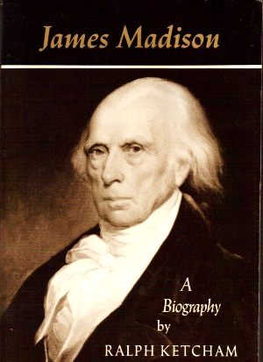
Why Does Truth & Media Integrity Matter?
“Nothing could be more irrational than to give the people power and to withhold from them information, without which power is abused.
A people who mean to be their own governors must arm themselves with the power which knowledge gives. A popular government without popular information or the means of acquiring it is but a prologue to a farce or a tragedy, or perhaps both.”
—James Madison

Slide 9

Why Are People Vulnerable to Opinions?
Instinctually everyone wants to survive, and the chances of survival improves when people fit into society and have social approval.
Psychologist Erik Erikson asserted that our identities are central to whether we fit in, and that society shapes our identities by way demonstrating its approval or disapproval of our personalities, sense of self, and behavior
People are vulnerable because public opinions warn them about what happens to people who are different or nonconforming
Many are vulnerable to opinions because they are ill-informed, uneducated, or not motivated to form their own beliefs and values

Slide 10
Understanding Mass Media: Wealth
In 1984, the total wealth of the media industry was $194 billion
In 2022, the total wealth of the media industry was $134 trillion
Since 1984, media has grown to include
  Streaming services
  Search engines
  Digital social media
  Wireless service
  Wireless applications

Slide 11
Understanding Mass Media: Ownership
By 2023, three companies (T-Mobile, Verizon, AT&T) controlled over 80% of wireless services
In 2009, five companies (Time-Warner, Viacom, Disney, General Electric, & Discovery) owned over 80% of cable networks
By 2009, the top three TV broadcast companies that controlled nearly 100% of stations in 1950 (ABC, CBS, NBC) controlled about 10% combined

Slide 12
Understanding Mass Media: Monopoly
The top six media corporations and some of their holdings in 2025 included:
Comcast (NBC, Universal Pictures, Xfinity, MSNBC, and Sky)
Disney (ESPN, ABC, Hulu, Pixar, Marvel, Lucas Studios)
AT&T (Warner Brothers, Discovery, HBO, CNN, TLC)
News Corps/Murdoch (Wall Street Journal, Fox news, New York Post, Harper Collins)
Paramount Global (CBS, Paramount, Nickelodeon, MTV, Showtime)
Sony (Sony Pictures, Sony Music)
Monopolies often restrict diversity in points of view and editorial freedom, which homogenizes the content of news and entertainment.
The Media Monopoly: How 6 Corps Control Almost All US Media. August, 2025. https://sciencestream.blog/media-monopoly-us-control

Slide 13

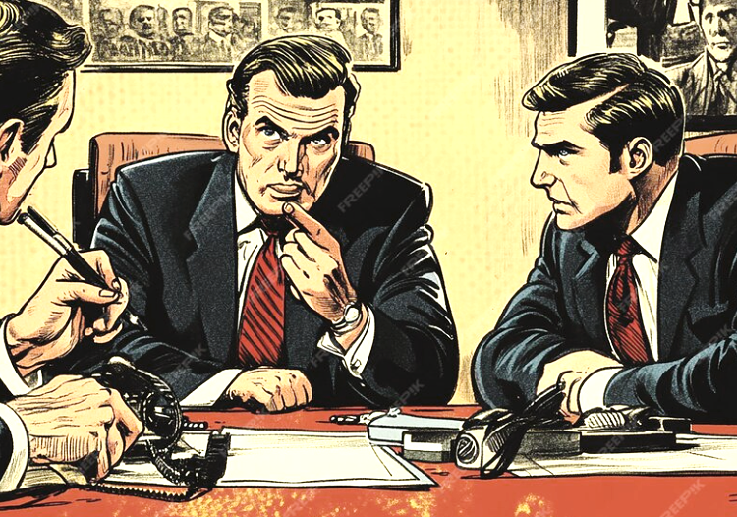
Understanding Mass Media: Competing Interests
We are here to make profit for ourselves and our stockholders, and if the public wants game shows, hate speech, and biased news reports, then that is what we will sell them.
We are here to serve the public’s need to be well-informed. We are interested in local and global perspectives. We believe in being objective and examining diverse opinions.

Slide 14
Elements of Critical Media Consumption
Element | Aspects of Elements
Purpose | Is the intent to inform, persuade, guide, refute, reinforce, clarify?
Question | What is the core question, concern, or issue?
Information | What facts, evidence, ideas, details, and context are offered?
Concepts | What theories, principles, and paradigms are key to assertions?
Interpretation | What conclusions and summations of importance are offered?
Assumptions | What is taken for granted; what is presumed about audience?
Implications | What is the logic of assertions; what is suggested but not explicit?
Perspective | Is the communication biased or take a partisan point of view?
Adapted from: Paul, R.& L. Elder. Fact Over Fake. Foundation for Critical Thinking,2020.

Slide 15




Criteria to Assess Communication Elements
How clear is the purpose, evidence, concept, and logic?
Does the scope of information address what should be addressed?
Is the information deep enough superficial or over-simplified?
How accurate are the assertions? Is the data reliable and current?
Do the conclusions and interpretations reveal the significance of the issues?
Are the details relevant to the issue?
Are assertions, use of evidence, and conclusions logical and well-reasoned?
Is the perspective biased and are the assertions and representations of ideas and facts fair?

Slide 16
Compare & Contrast These Two Accounts: What Do Readers Know? What Do They Not Know?
Story A
Story B
Two people died from injuries sustained in a fire last Tuesday in the Tenderloin district of San Francisco. Dave Hoffman and Eve Rolfson managed the building but were unable to escape fire and smoke after fire broke out shortly after 1:30 AM. Three more victims remained hospitalized. Investigators determined the blaze began in the hallway outside Hoffman’s apartment and found several empty bottles of alcohol in the debris. Nine other residents of the apartment building escaped the flames. One of the couple’s neighbors said, “I woke up when the smoke alarms went off and shouted to Dave from the hallway, but by that time I knew the fire was inside their unit.” Another renter said that the lock on the back entrance was broken and that “anyone could get in any time.” The owner of the building could not be reached for comment.
Two victims of the fire that swept through a dilapidated building in the Tenderloin district of San Francisco have died. Three others burned in the blaze are in stable condition. Dave Hoffman and Eve Rolfson were overwhelmed by smoke after a fire broke out shortly after 1:30 AM in the hallway outside their unit. Investigators found several empty bottles in the debris and forensics are exploring the possibility they contained accelerant. Nine other residents of the apartment building escaped unharmed. Hoffman’s neighbor said, “I woke up when the smoke alarms went off and shouted to Dave.” Another neighbor reported that none of the alarms went off. She noted, that “junkies break in all the time, because the landlord stopped repairing the windows and locks at the back entrance.” The negligent owner of the building could not be reached for comment.

Slide 17
Things to Consider
Sources of news — individuals, companies, and publishers— have incentives to present information in certain way
Not all eyewitnesses tell the truth or remember details
Knowing the specific interests of the sources helps put the information and opinions they offer in perspective
It is difficult to assess the objectivity of news and opinions with limited knowledge of the issue or subject
The prominence of a story on the pages of a newspaper or website does not necessarily mean the story is important
The language people use to tell stories reveals how they value human life and human dignity, and we have a choice to accept or reject how others value human life and dignity

Slide 18
Questions for Reflection & Discussion
Do I have strong feelings about this subject even though I know little about it and if so, why?
Do I pay attention to the news only when it relates to my personal life or interests, or am I interested in what happens to people I don’t know? Why?
How much effort do I exert trying to understand other people’s opinions?
What are the “liberal” news sources I consult and what are the “conservative” news sources I consult? Why?
Do I know where to find alternative perspectives on issues and why they matter?

Slide 19
Additional References
Bagdikian, Ben. The Media Monopoly 4th edition. Boston: Beacon Press. 1992. [Free viewing: Internet Archive. The media monopoly : Bagdikian, Ben H : Free Download, Borrow, and Streaming : Internet Archive
Barclay, Donald. Fake news, Propaganda, and Plain Old Lies: How to Find Trustworthy News in the Digital Age. Lanham, MD: Rowman & Littlefield. 2018.
Ceppos, Jerry. (Ed.) Covering Politics in the Age of Trump. Baton Rouge: Louisiana State University 2021.
Fairness and Accuracy in Reporting is a media watchdog that offers readers data, commentary, and reports that reveal the effects of fake news, media monopoly, and examples of how language can be manipulated to sway opinions and attitudes. FAIR — FAIR is the national progressive media watchdog group, challenging corporate media bias, spin and misinformation.
Paul, R. & L. Elder. The Thinker’s Guide for Conscientious Citizens on How to Detect media Bias and Propaganda in the National News. Foundation for Critical Thinking, 2008.

